Slide 1
Poverty in Johnson County
Primary Data Source:
U.S. Census Bureau American Community Survey 1-year estimates, 2014
Prepared January 2015

Slide 2
United Community Service of Johnson County (UCS)
Provides Data Analysis: Provide information, trend analysis and documentation to enhance community-wide planning and decision-making
Lead Collaborations: Bring people together to improve human service delivery.
Leverage Resources: Secure funding for this community’s human service organizations by partnering with local governments and applying for competitive grants.
Key Partners: Human Service Providers/Nonprofit Agencies
Johnson County Government and Cities
United Way of Greater Kansas City
Notes:
Human services are those that help prevent, promote or restore the well-being of individuals and families. While everyone benefits from human services over the course of a lifetime, those who are poor have greater need for, and less ability to access, help in order to gain economic stability.
For the past 18 months UCS has been working in partnership with Johnson County government to identify and implement local strategies to address poverty. While poverty is a complex issue, without a single solution there are effective strategies that work.
We believe that our business community needs to be engaged with efforts to reduce poverty and create opportunity, in order to sustain a thriving community. Regardless of where you live or work in Johnson County, poverty is your neighbor. But who is poor may not be the same as who you think is poor. And fewer people than you might think, are helped by the public safety net. We believe that work should be a pathway out of poverty, but for that to happen, business leaders must be willing to take action. I’m pleased to have this opportunity tell you about poverty in our community and the role that business can play to address poverty..

Slide 3
If poverty was a city
Notes:
To put poverty in perspective, if poverty was a city, it would be the 5th largest city in Johnson County, with 37,000 residents. When compared to counties statewide, Johnson County has the 3rd largest poverty level population– trailing Wyandotte County by only 1,000 people.
CLICK If Johnson County was a city, It would have been the fastest growing city between 2000 and 2014, increasing by 140%, compared to overall county growth of 26%.

Slide 4
How is poverty defined? 2015 Poverty Guidelines
Persons in family/household | <100% FPL Poverty
1 | $11,770
2 | $15,930
3 | $20,090
4 | $24,250
Each additional person add | $4,160
_{$9.66 per hour}
Source: U.S. Census Bureau
Notes:
Before we move forward, it is important to understand how poverty is defined. The U.S. Census Bureau annually sets thresholds and measures those who fall below those thresholds. This information helps our country and local communities understand the scope and trends overtime related to income insufficiency.
Anything that would be considered income for tax reporting purposes is included. But the value of public benefits individuals and families might receive such as food assistance is not.
From the chart you can see that for a family of three, 100% of poverty is currently an annual income of less than $20,090, (CLICK) which translates to $9.66 an hour for full time, year round work. When you compare this to what your household expends for basic needs such as housing, health care, child care, transportation, I think you will agree that it would be difficult to live with income below the poverty level.

Slide 5
Johnson County Poverty Data
 | 2000 |  |  | 2007 |  |  | 2014
 | Number | Poverty Rate |  | Number | Poverty Rate |  | Number | Poverty Rate
People below 50% of poverty Extreme Poverty | 6,810 | 1.5% |  | 8,070 | 1.6% |  | 14,720 | 2.6%
People below 100% of poverty Poverty | 15,330 | 3.4% |  | 22,000 | 4.2% |  | 36,970 | 6.5%
People below 200% of poverty Low-income | 48,300 | 10.8% |  | 74,180 | 14.3% |  | 96,850 | 17.0%
Source: U.S. Census Bureau; American Community Survey 1-year estimates
Notes:
The reality is that thousands in our community do live with income below the federal poverty level, and the numbers have more than doubled since 2000. This chart shows data for three poverty thresholds . Based on the latest data from the census bureau, 15,000 people have income that is less than one-half the poverty level, living in what is described as extreme poverty. That’s about $10,000 for a family of 3. Nearly 37,000 people, or 6.5% of the county’s population live with income less than 100% of the federal poverty level. Nearly 100,000 people or 1 in 6 county residents has income less than 200% of the poverty level, which is about $40,000 for a family of 3. Income at the 200% of poverty is typically described as low-income.
People with income below the poverty level have always lived in our community. But in the early years of this century, here and across the nation, more people of all income levels, including lower incomes, were moving to the suburbs. People moved to the suburbs in search of the same thing - better job opportunities, good schools and safer neighborhoods. By mid-decade, both nationally and locally, a larger portion of the poor were living in the suburbs. That trend is reflected in the growth between 2000 and 2007.
But since 2007, the data suggests something else. Poverty has continued to climb, and the poverty rate is higher now than before the great recession. Recession-related fiscal challenges – job loss, unemployment and underemployment reduced overall household income even for long-time county residents. And many households have never recovered. Now, the growth in jobs that pay low wages suggests a new normal for our community and daunting challenges for people trying to work themselves out of poverty.

Slide 6
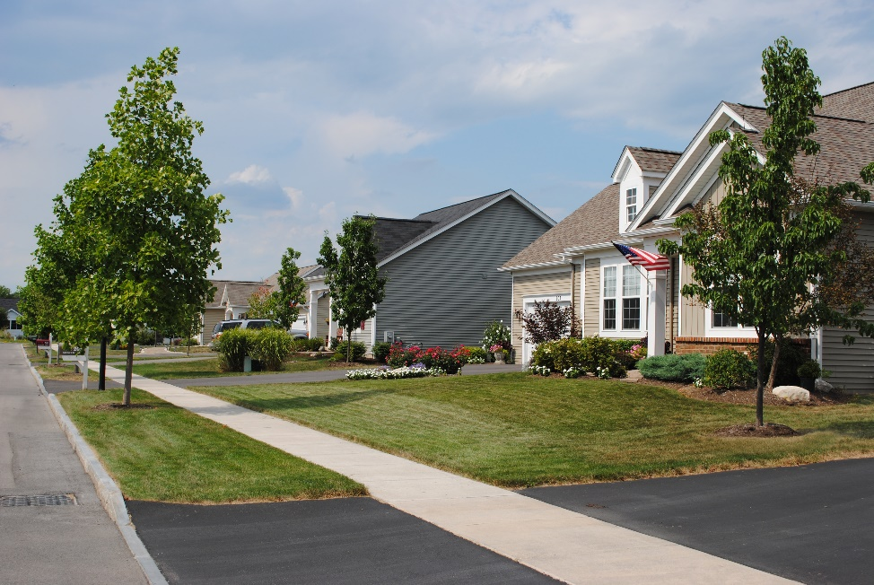
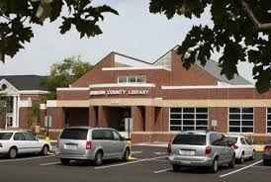
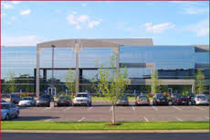
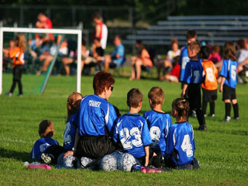
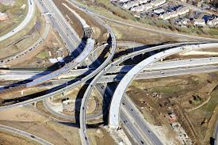
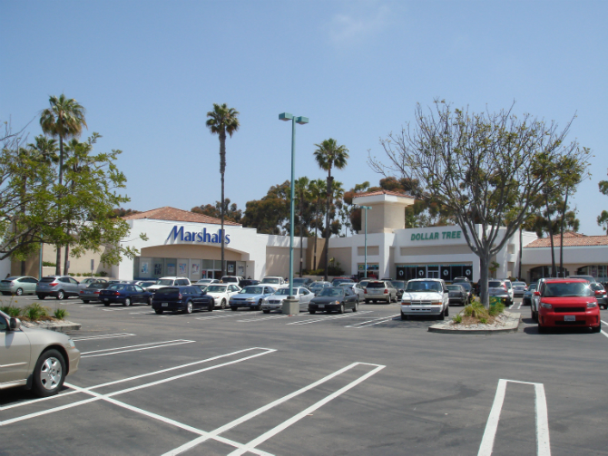
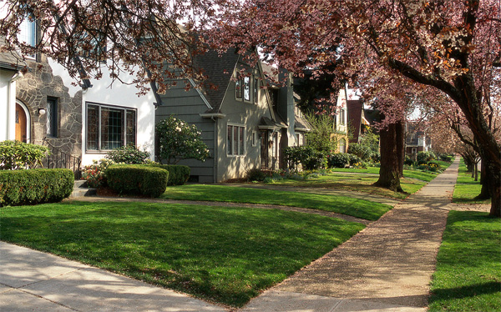
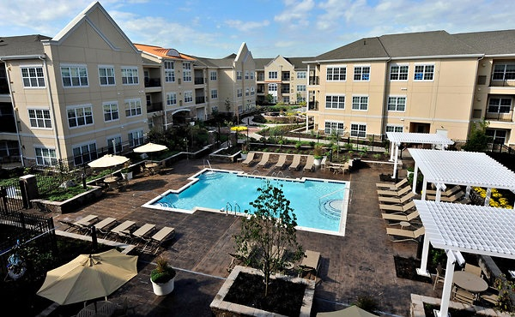
A thriving community benefits us all
Notes:
Why should business leaders care about growing poverty? Business is the lifeblood of our economy, businesses provide employment opportunities for our residents, create the goods and services we need and want, and pay taxes that support our public services. Business and society are closely intertwined and interdependent, each requiring the other to be healthy and productive in order to achieve its own objectives.
As a business leader, you understand that a thriving community benefits us all. But you may not have considered the fact that poverty can harm not only the individuals who live in poverty, but the community.

Slide 7
Costs to Society
Lower student achievement in schools
Loss of human potential and productivity
Reduction of workforce readiness and economic competitiveness
Worse health outcomes, higher health insurance premiums, and higher medical costs
Increased crime and the rising cost of criminal justice
Erosion of a tax base
Estimated real costs annually:
$250 Billion to $500 Billion
The High Public Cost of Low Wages, UC Berkley Labor Center, 2015
The Economic and Societal Costs of Poverty, House Hearing, 110 Congress, 2007
Notes:
When individuals and families don’t have adequate income, they face daily hardships – such as hunger, poor housing conditions, homelessness, and lack of health care. Studies show that stress is much higher for the poor, as well as chronic pain.
But poverty doesn’t just affect those who directly experience it. It costs all of us in very tangible ways. Lower student achievement leads to reduced productivity. Our economy suffers because we don’t have the skilled workforce needed or people with adequate income to buy goods and services in order to expand and grow the economy. Public safety is threatened, leading to both personal loss and public expense. Overall our quality of life suffers.
Poverty particularly harms children – Children who live in families below the poverty line, even for short periods, are at greater risk of lower cognitive development and educational attainment, increased reliance on public benefits and increased rates of incarceration. Consequently, children who grow up in poverty are more likely to have lower lifetime earnings due to poverty. This means they are far less likely to grow up to become contributors to our economy and our society.
CLICK Some research estimates that the annual costs to American society at between 250 and 500 billion dollars each year in lost productivity, health costs, and anti-poverty programs. So, not only is a focus on poverty the right thing to do, but it is in our own best interest as a society to understand the facts and find real solutions.

Slide 8
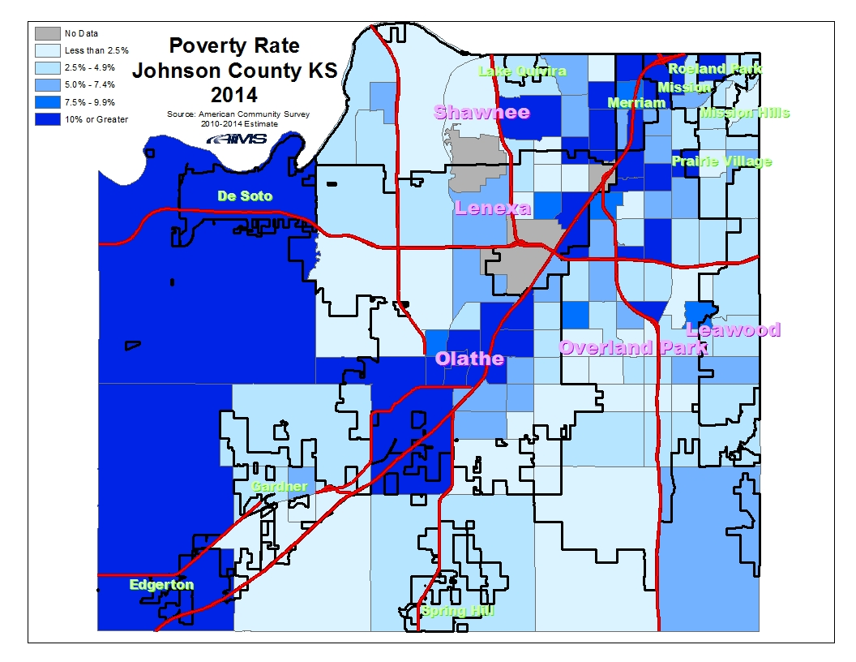
6.5%
Notes:
Travel to any part of Johnson County and you will find people living in poverty. You encounter them every day. They serve you lunch, clean your office, go to school with your children, ring up your purchases, and care for your elderly parents. They are your neighbors and co-workers.
This map of Johnson County by census tract demonstrates that people with poverty level income live all across the county and in every census tract. Although it can be higher or lower than the county-wide 6.5% poverty rate depending on location.
The darkest blue represents poverty levels of 10% or greater. 1 in 4 of the county’s 127 census tracts has a poverty rate of 10% or higher. 13 tracts have poverty rates higher than 15%. Higher concentration of poverty is often found closer to major highways, as that’s typically where lower cost housing is located.

Slide 9
Number below poverty by school district Ages 5-17
Poverty Rate
10.7%
8.1%
3.2%
8.0%
3.9%
5.2%
U.S. Census Bureau, Small Area Income and Poverty Estimates
Notes:
Johnson County residents often identify with a school district. So, here’s another way to think about the geography of poverty. This graph of children ages 5-17 and living in poverty clearly demonstrates the fact that poverty is a county-wide issue. It also graphically shows the upward trend in poverty experienced in this community since 2000. The trend line for every district shows the number in poverty higher now than before the recession.
The Shawnee Mission School District catchment area has the largest number of children living in poverty, about 3,700. And that area has the highest child poverty rate, 10.7%. Shawnee Mission is followed by Olathe with 2500 children below poverty and an 8.1% poverty rate. The district with the largest percentage increase in students below poverty is Blue Valley. The number of poor students increased almost 7 fold since 2000.

Slide 10
Poverty has many faces
The majority are white
The majority are U.S. citizens
The majority of poor adults work
The majority of poor adults have at least some college education
Source: U.S. Census Bureau, American Community Survey 1-year estimate, 2014
Notes:
There is no single description that fits those Johnson County residents who live with income below poverty. Every individual and family has a unique story. Based on data from local service providers the stories most often include under or unemployment, significant medical issues or disability, or disruption in the household due to death, domestic violence or divorce.
Data from the Census Bureau tells us that the majority of residents with poverty level income in Johnson County are white, the majority are U.S. citizens, the majority of poor adults work at least part-time or part-year, and the majority of poor adults have at least some college, and one-fourth have a bachelors degree or higher.
Most people who become poor do not spend a long time in poverty. But for those who do, the longer a person is poor, the less likely he or she is to escape poverty.

Slide 11
Some groups experience poverty at higher rates
Source: U.S. Census Bureau, American Community Survey 1-year estimate, 2014
Notes:
Some groups do experience poverty at higher rates – people of color, people with disabilities, people without a high school diploma, and children living with one parent. But these groups do not account for a majority of the poor.

Slide 12
The majority of the poor work
Adults 18-64 below the poverty level and without a disability that prevents work = 18,980
Source: U.S. Census Bureau, American Community Survey 1-year estimate, 2014
Notes:
At UCS, we believe that work should provide a pathway out of poverty. Yet, the data tell us that most of the working age poor are doing just that – working. However they do not work enough hours or earn high enough wages to rise above the poverty level . Nearly 1 in 6 poor adults worked full time, year-round, yet even with full time wages they were poor. More than 6 in 10 half worked part time or part year. Only 24% did not work,
Often the jobs that these workers hold pay low wages, offer only part-time or temporary work, may have unpredictable schedules and likely do not offer paid benefits such as sick leave. Nor do they offer an opportunity for advancement. As a result, the poor are working hard but not getting ahead.

Slide 13
1 in 9 jobs pay less than $10 an hour Johnson County average hourly wages
Annual wages for full-time, year-round work
$10 = $20,800
$15 = $31,200
$20 = $41,600
$30 = $62,400
2015 Jobs = 368,200
Source: Mid-America Regional Council. EMSI 3Q 2015
Notes:
According to data on wages paid by Johnson County employers, 1 in 9 jobs pay less than $10 an hour. Another 22% pay between $10 and $15 an hour. Together one-third of jobs in Johnson County pay less than $15 an hour, which is equivalent to $31,200 for full time year round work. That amount is about 150% of the federal poverty level for a family of 3.
Employment projections for the area suggest that the largest employment growth through 2022 will be predominantly low-wage occupations, such as sales clerk, restaurant worker, cashier, and personal care aide. Supporting a family and getting a secure foothold in life is challenging when job opportunities are concentrated in low wage jobs.

Slide 14
Insufficient income requires difficult choices
$1,674 Poverty Level
Source: Economic Policy Institute
Notes:
An individual or family with income at or below the federal poverty level has limited funds to spend on life’s essentials such as a safe place to live, health care, reliable transportation, nutritious food and child care, if necessary. Consequently, difficult choices must be made about where to live, who cares for children while a parent works, whether to see a doctor when ill, and dozens of other choices that are income – driven. An estimate by the Economic Policy Institute puts the monthly cost to meet basic needs for a single parent with two children at close to $5,000. A significant portion of the budget is taken up by child care, which is a necessity for a working parent. CLICK A parent with income below the poverty level, has anywhere from 0 to $1674 to spend for all of that family’s essentials, less than one-third of what’s needed.

Slide 15
The Public Safety Net Falls Short
Notes:
When income from employment falls short or an adult is unable to work, there are few options that provide consistent, sustainable income. While the public safety net is designed to help people undergoing hard times meet their basic needs and get back on their feet, it is not adequate to help most people who are struggling.
While some with no or very low income may be eligible for food stamps, or other safety net program, adults without dependent children are eligible for few programs. Very poor families with children are eligible for more types of assistance, but even then, few receive public cash assistance.
In Kansas, a family of three may be eligible for cash assistance if it has income less than $500 a month. Benefits amount to about $100 a month per person. However, only a small portion of poor children are helped by this program, and that number is declining due to state changes in policy and practice. In 2010, for every 6 children below poverty, 1 was enrolled in Temporary Assistance to Needy Families, or TANF. In Nov. 2015, 537 Johnson County children received TANF, or 1 in 20. There are 12,000 poor children in Johnson County.
Families with little or no income in the house cannot meet basic needs. This puts families and children at a very high risk for experiencing further crisis, and makes finding employment more difficult.

Slide 16
What Business Can Do
Actions you can take that are good for business and good for the community:
Make every job a good job
Offer good starting wages and opportunity of wage growth, gender equity in pay, predictable hours of work, flexible scheduling, earned sick days, health insurance.
Adopt fair chance hiring policies
Give applicants with a criminal history an opportunity to compete for jobs
Support policies that strengthen early childhood development, K-12 public education and public safety net
Understand where candidates for elective office stand on the issues
Contribute time, talent and wealth to safety net programs
Serve on a board, sponsor an event, make a corporate/personal donation
Notes:
The challenges that individuals, families and children face, despite their best efforts, remind us that we all have a role to play in addressing poverty. As a member of the business community, you have a unique role. For most, employment is the only pathway out of poverty, and business is the source of jobs. Here are specific actions that business can take to reduce poverty and create opportunity.
CLICK Make every job a good job : Research has shown that employees who enjoy a healthy work life balance are more productive, motivated and stay longer in their jobs. In addition, they have less absenteeism and lower health care costs. Good jobs include good starting wages and opportunity for wage growth; gender equity in pay; opportunity for advancement, predictable hours of work, flexible schedule, earned sick days, and health insurance.
CLICK Adopt fair chance hiring policies: Nearly 1 in 4 working age Kansans has a criminal history which can create barriers to entering the labor market after incarceration. A fair chance hiring policy would allow people who were formerly involved with the criminal justice system to compete for jobs for which they are qualified, without being disqualified solely due to previous criminal history.
CLICK Support policies that strengthen early childhood development, K-12 public education and public safety net: Policy and budget choices can be a barrier, or they can provide the necessary public support to ensure children have the learning opportunities and daily essentials they need for future success.
CLICK Johnson County business leaders are very generous with support of nonprofit organizations. You can continue to contribute time, talent and wealth to safety net programs. And if possible, increase your support for community-based organizations.
Because business is critical to an effective local response to poverty, UCS plans this spring to launch a planning process to explore strategies. Johnson County Community College, KU Edwards Campus, Johnson County Government, Workforce partnership and others will be partners.

Slide 17
Contact Information
Karen Wulfkuhle
karenw@ucsjoco.org
Valorie Carson
valoriec@ucsjoco.org
913-438-4765

